Slide 1








Microsoft SDL
Microsoft Security Development Lifecycle
June 2021

Slide 2



Microsoft SDL
About Me
Descriptions
Amin Bagheri,
Senior software developer at Mofid securities
amindotb@gmail.com
Follow
Security trends
It has become appallingly obvious that our technology has exceeded our humanity.
Inspiration
New technologies
Albert Einstein
2

Slide 3
Microsoft SDL
Agenda for Today
01.
Welcome
02.
Why software security?
03.
Phases
About the topic
A quick recap of application security and why we choose Microsoft SDL.
Microsoft SDL phases in deep.
04.
Comparison
05.
Other ways
06.
Final talk
We will have look at the result of Microsoft SDL on their products.
Have a look at similar process like Microsoft SDL.
Last things …🎉
3

Slide 4

Microsoft SDL
Welcome Message
Introducing
Microsoft SDL
The Security Development Lifecycle (SDL)
Consists of a set of practices that support security assurance and compliance requirements. The SDL helps developers build more secure software by reducing the number and severity of vulnerabilities in software, while reducing development cost.
microsoft.com/en-us/securityengineering/sdl/practices
5^{.2}
Since 2004
4

Slide 5
Microsoft SDL
Tell your
story
How your weekend falls apart with a call!
5

Slide 6
Microsoft SDL
Why application security?
70%
Application Layer = Weak Point
of IT security budget is spent on Infrastructure
The OS Layer and Network layer are too hard now
+75%
“ Hackers are very smart, we need better security ”
75% of attacks happen at the Application level
1/3
developers are confident that they write secure code
6

Slide 7

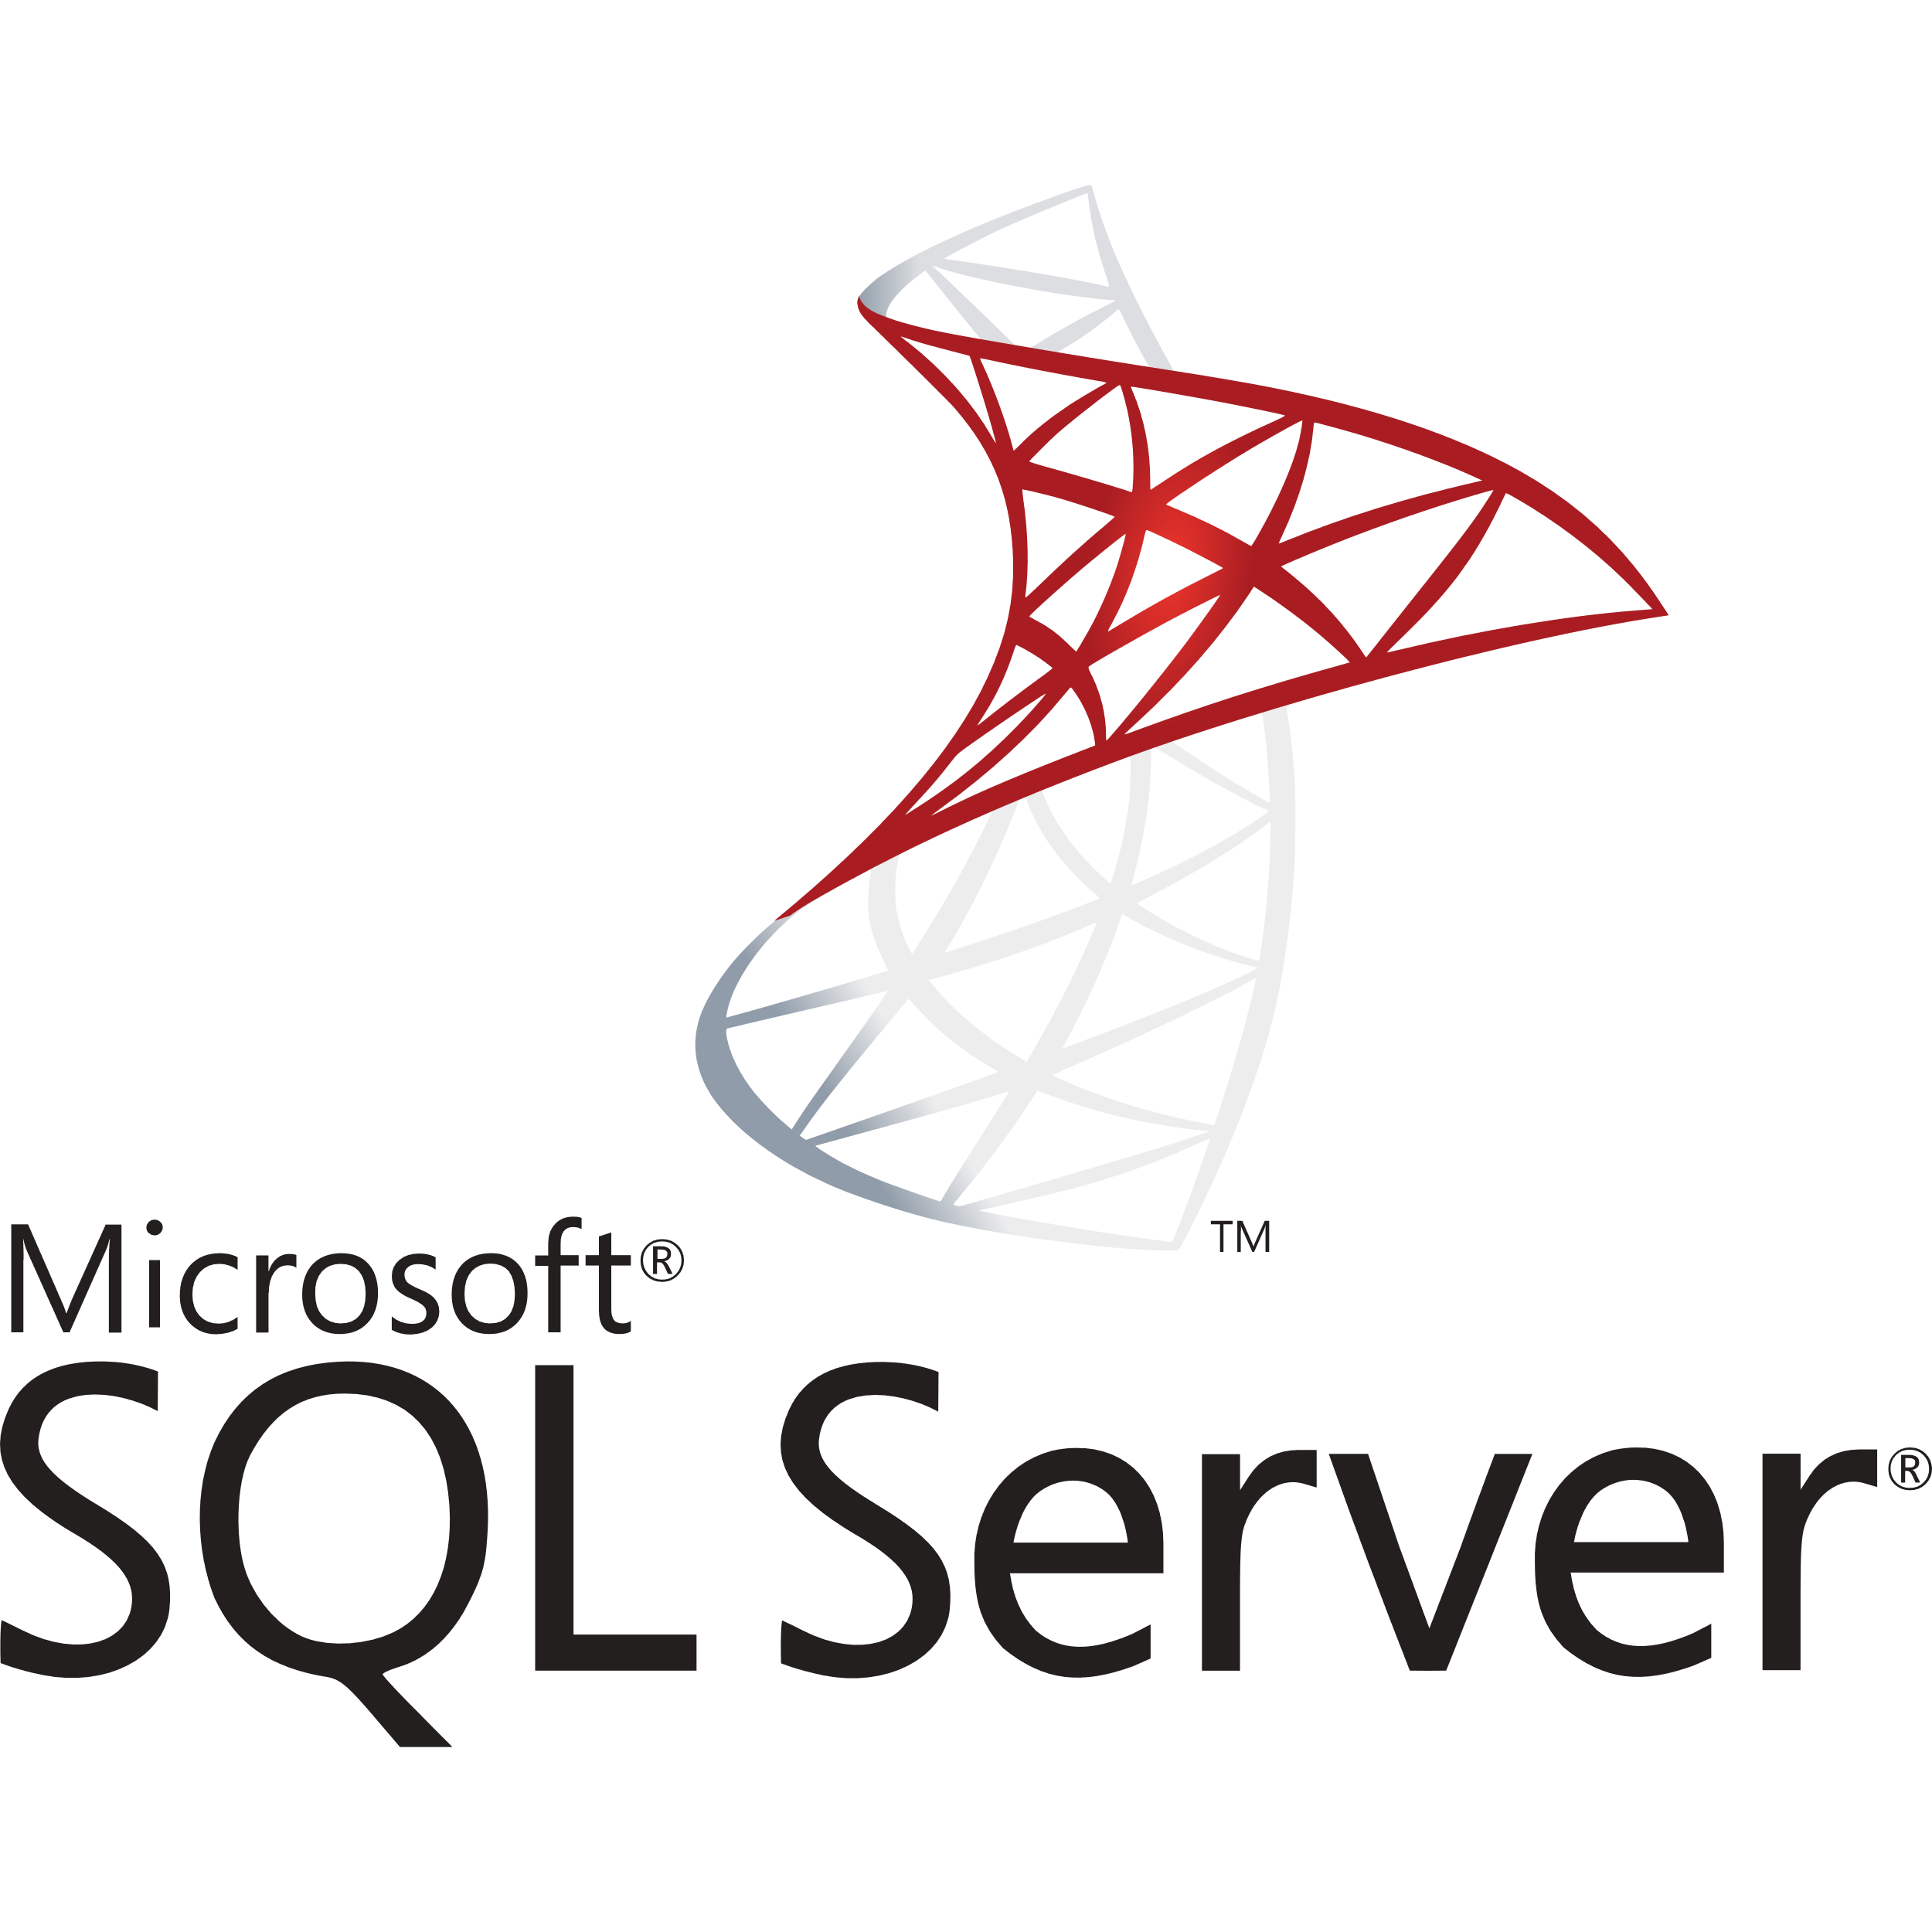


Microsoft SDL
Why SDL?
Purpose of SDL
The SDL is NOT Optional
1#
At Microsoft all line-of-business application teams must go through SDL
Inventory and assess applications
2#
Identify and ensure resolution of security/privacy vulnerabilities
3#
Enable Application Risk Management
7

Slide 8
Microsoft SDL
Timeline
2004
2007
SDL was born
First public release
2002
2005
2009
TwC,
Bill Gates email
Updates
(1.0 to 3.0)
First public tools release
8

Slide 9
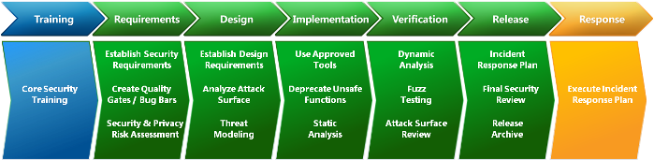
Microsoft SDL
Phases
Source: https://docs.microsoft.com/en-us/previous-versions/windows/desktop/cc307406(v=msdn.10)
9

Slide 10


Microsoft SDL
Training
(1 of 7)
SDL standard
Provide training
“Core Security training”
Individuals who develop software programs should attend at least one security training class each year.
Security is everyone’s job. Developers, service engineers, and program and product managers must understand security basics and know how to build security into software and services to make products more secure while still addressing business needs and delivering user value.
10

Slide 11
Microsoft SDL
Training
(1 of 7)
Review
Secure design
Attack surface reduction
Defense in depth
Principle of least privilege
Secure defaults
Secure Coding
Buffer overruns
Integer arithmetic errors
Cross site scripting
SQL injection
Weak cryptography
Managed code issues
Privacy
Types of privacy data
Privacy design best practices
Risk analysis
Privacy development best practices
Privacy testing best practices
Threat Modeling
Overview of threat modeling
Design to a threat model
Coding to a threat model
Testing to a threat model
Security Testing
Security testing vs Functional testing
Risk assessment
Test methodologies
Test automation
11

Slide 12

Microsoft SDL
Requirements
(2 of 7)
Security Requirements
Assign security responsibilities, responsible and advisor(audit)
Security level
Critical
Important
Moderate
Low
None
Quality Gates/Bug Bars
Defined to stablish minimum acceptable level of security and privacy
e.g:
All compiler warnings must be triaged and fixed prior to code check-in
No known vulnerabilities in the application with a “critical” or “important” rating at time of release.
How risky is to my business. Release or not!
Security bug effect
)STRIDE(
Spoofing
Tampering
Repudiation
Information Disclosure
Denial of Service (DoS)
Elevation of Privilege (EoP)
Security and Privacy Risk Assessment
Privacy risk levels:
P1 – High Privacy Risk
P2 – Moderate Privacy Risk
P3 – Low Privacy Risk
12

Slide 13
Microsoft SDL
Design
(3 of 7)
Design Requirements
Security and privacy that we exposed directly to users
Attack Surface Reduction
Shutting off or restricting access to system services or firewall rules
Threat Modeling
A team exercise to create a model and maintain it
13

Slide 14
Microsoft SDL
Implementation
(4 of 7)
Use Approved Tools
Versions, compilers, modules libraries.
Deprecate Unsafe Functions
Like: Banned.h
Static Analysis
Addons, Manual code review
14

Slide 15
Microsoft SDL
Verification
(5 of 7)
Dynamic Program Analysis
Memory corruption, user privilege issue
app verifier
Fuzz Testing
Like: MiniFuzz
Threat Model and Attack Surface Review
Reviewing models and surface review
15

Slide 16
Microsoft SDL
Remember?
Training
Implementation
Requirements
Design
We are here
Verification
Response
Release
16

Slide 17
Microsoft SDL
Release
(6 of 7)
Incident Response Plan
Set tier response plan and on-call developers, even for 3rdparty applications
Final Security Review
Some other revies by advisor and check if review results from other steps has been resolved
Release/Archive
Builds, source codes, threating models, bug bars
17

Slide 18
Microsoft SDL
Release
*Optional
Manual Code Review
White-box test, Code review code review and more code review
Penetration Testing
Penetration tests with software or manual test
Vulnerability Analysis of Similar Applications
Check other similar applications vulnerability for similar issues
18

Slide 19
Microsoft SDL
Response
(Final step)
Always be available
The dedicated members of project always should be available to deal with threats
Accessing to docs
The response team has access to all document which created from the other cycles.
Monitoring
Always monitoring the pre set triggers in development or raw data
19

Slide 20
Microsoft SDL
Before vs After
55%
91%
Decreased
Decreased
119
34
66
3
Windows XP
Windows Vista
SQL server 2000
SQL server 2005
After 1 year after release
After 3 year after release
Source: Microsoft security blog
20

Slide 21
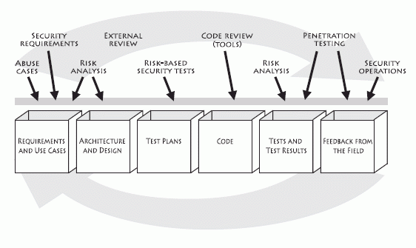
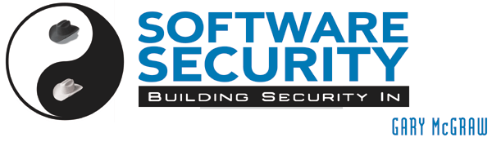
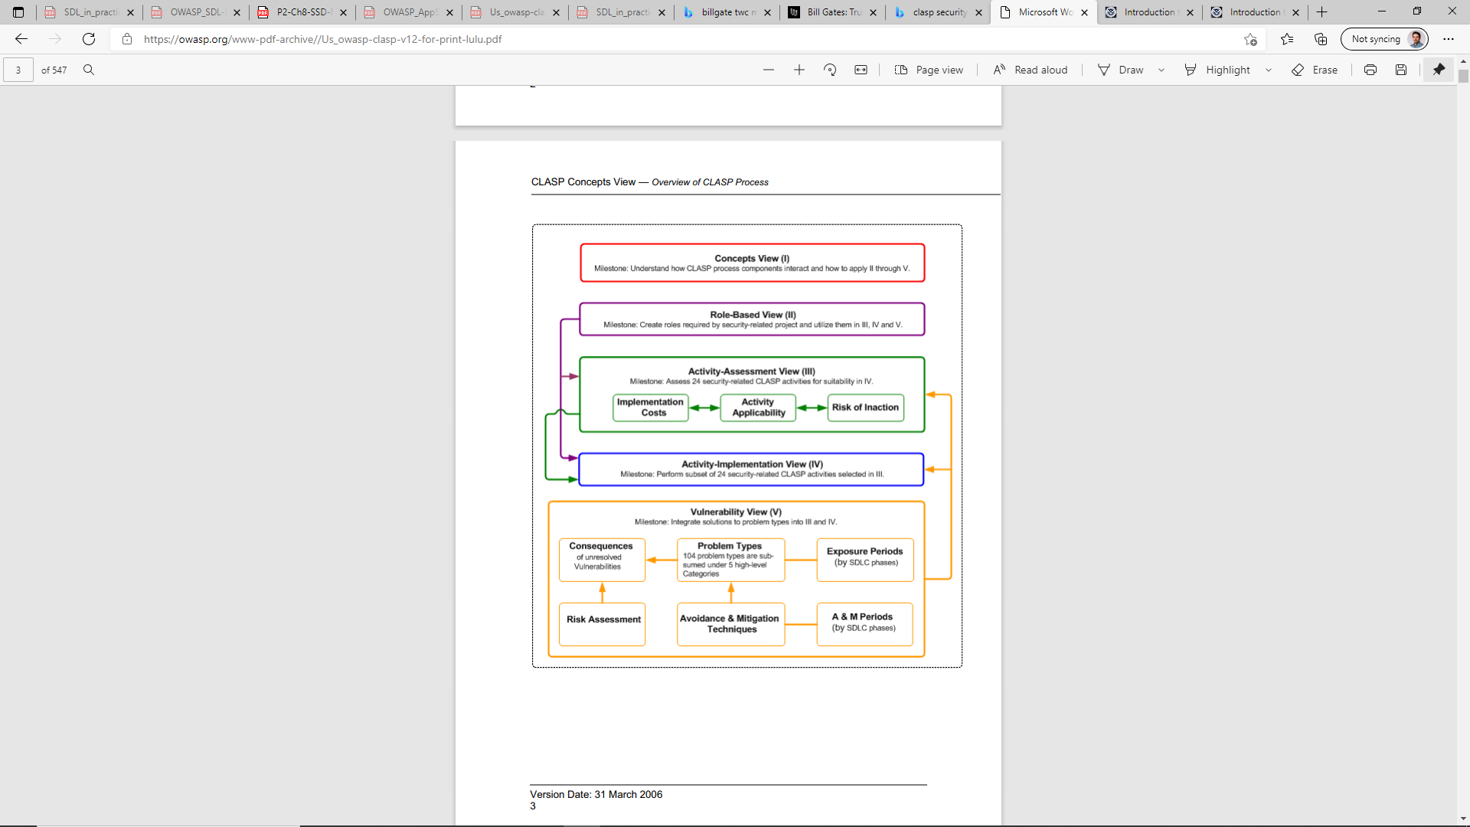


Microsoft SDL
Similar
TouchPoints
http://www.swsec.com/resources/touchpoints
CLASP
https://owasp.org
Gartner
Safecode
https://www.gartner.com/en/conferences/na/security-risk-management-us
https://safecode.org/
21

Slide 22

Microsoft SDL
Case studies
https://www.microsoft.com/en-us/securityengineering/sdl/practices
https://docs.microsoft.com/en-us/previous-versions/windows/desktop/cc307748
https://owasp.org
https://hackingblogs.com
https://www.cvedetails.com
http://www.toolswatch.org/
https://www.armourinfosec.com/blog
https://www.guru99.com/ethical-hacking-tutorials.html
https://www.ehacking.net
22

Slide 23
Microsoft SDL
Thank You

Slide 24
If you can see this,
you have enough attention to be an expert
24

